Slide 1
Spring Boot Series – Day 10
Topic: Spring Boot Security – JWT Authentication
&
Role-Based Access
@CodeByHaindavi | #SpringWithMe

Slide 2
Why API Security Matters?
✔️ APIs are the gateway to your application’s data and services.
✔️ Any loophole can be exploited to gain unauthorized access, inject data, or misuse logic.
✔️ Securing APIs is not optional — it’s foundational to protect user data and prevent breaches.
✔️ Spring Security gives us precise control — both broadly and surgically.
@CodeByHaindavi | #SpringWithMe

Slide 3
Authentication vs Authorization
✔️ Authentication is about WHO you are — verifying your identity (e.g., JWT login).
✔️ Authorization is about WHAT you can do — controlling access based on roles/permissions.
✔️ Both are equally crucial — think of logging into a bank vs. being allowed to transfer funds.
✔️ Spring Security supports both — and decouples them to let you manage access cleanly.
@CodeByHaindavi | #SpringWithMe

Slide 4
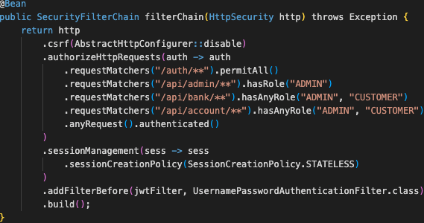
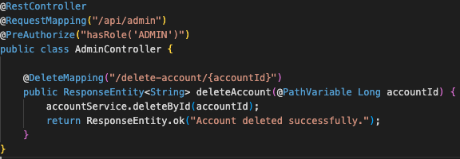
Endpoint-Level Authorization
✔️ In real projects, you often want different users to access different parts of your application — and this starts with securing URLs in the SecurityFilterChain using http.authorizeHttpRequests().
✔️ You control access to REST endpoints via role-based rules in the security config.
✔️ For example, only 'ADMIN' users can access /admin/delete, while all logged-in users can access /transactions.
✔️ This is done using `antMatchers()` or `requestMatchers()` in `SecurityFilterChain`. It's the first line of defense for your APIs — especially public-facing ones.
@CodeByHaindavi | #SpringWithMe

Slide 5

Method-Level Security — Why & When
✔️ Endpoint-level rules are helpful, but in real applications, critical business logic often lives deep inside services, not just at the controller level.
✔️ That’s where method-level security shines — using annotations like @PreAuthorize, you can apply access checks directly on methods, ensuring no one bypasses rules through internal calls or alternate routes.
✔️ For example, even if a URL is technically accessible, a method like deleteAccount() can enforce: “Only the actual owner of the account or an admin can delete this” — regardless of where the call originated.
✔️ This adds a second layer of protection, especially valuable in layered architectures or when multiple endpoints trigger the same method with different permissions.
@CodeByHaindavi | #SpringWithMe

Slide 6
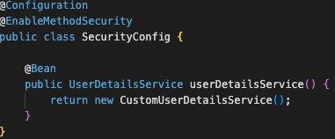
Enable Method-Level Security
✔️ To activate annotations like @PreAuthorize or @PostAuthorize, you must explicitly enable method-level security using @EnableMethodSecurity(prePostEnabled = true) in your security configuration class.
✔️ Without this, Spring Security won’t evaluate any role or permission checks written on methods — they’ll simply be ignored, even if the annotation exists.
✔️ Once enabled, Spring internally processes these annotations before the method is executed, allowing you to block access even before the logic starts running.
✔️ This only works if your authentication system correctly populates the user’s roles or authorities inside the Authentication object — typically handled via your custom UserDetailsService and JWT claims.
@CodeByHaindavi | #SpringWithMe

Slide 7
`@PreAuthorize` in Action
✔️ @PreAuthorize runs a security check before the method is executed, ensuring unauthorized users never reach the business logic.
✔️ You can use it to validate roles (hasRole('ADMIN')), ownership (#userId == authentication.principal.id), or any condition via Spring Expression Language (SpEL).
✔️ It's extremely useful when the same endpoint serves different users but the internal method needs tighter control — like enforcing account ownership.
✔️ Real-world examples: only managers can approve leaves, only customers can access their transactions, only admins can delete accounts.
@CodeByHaindavi | #SpringWithMe

Slide 8
Other Annotations: `@Secured` & `@RolesAllowed`
✔️ @Secured("ROLE_ADMIN") is a simpler, older annotation used for role checks — but it lacks support for dynamic conditions or SpEL.
✔️ @RolesAllowed("ADMIN") comes from JSR-250 and offers similar behavior — still limited to static role checks only.
✔️ Both work fine for basic use cases, but they can’t validate inputs or user-specific logic like @PreAuthorize can.
✔️ In real projects, prefer @PreAuthorize for its power, flexibility, and cleaner integration with modern Spring Security patterns — unless your org mandates a specific annotation style.
@CodeByHaindavi | #SpringWithMe

Slide 9
Combining Endpoint + Method Security
✔️ Endpoint-level authorization controls who can access which URLs — it’s the first checkpoint at the door.
✔️ Method-level security protects the business logic itself, ensuring only valid users can execute specific operations.
✔️ Using both together creates defense in depth — if one layer is bypassed, the other still holds the line.
✔️ Think of it like a security gate + a vault code — both are needed to fully secure the application.
@CodeByHaindavi | #SpringWithMe

Slide 10
Role Hierarchies & Custom Logic
✔️ Spring supports role hierarchies, so you can define that ADMIN automatically inherits permissions of MANAGER and USER — making access control cleaner.
✔️ For advanced use cases, plug in a custom PermissionEvaluator to handle logic like record-level permissions, approval chains, or dynamic conditions.
✔️ Keep your authorization logic testable and auditable — don’t bury complex checks inside annotations if they’re better handled in service methods.
✔️ As a best practice, use annotations (@PreAuthorize) for simple rules and delegate complicated logic to a central, reusable method — this avoids clutter and keeps your code maintainable.
@CodeByHaindavi | #SpringWithMe

Slide 11
📌 Hands-On Tip
✔️ Always prefix roles with ROLE_ when using @Secured or hasRole() — Spring expects it by default. So hasRole("ADMIN") checks for ROLE_ADMIN behind the scenes.
✔️ Don't expose too many permitAll() endpoints. During dev, it’s common to open things up for quick testing — but always audit and lock them before release.
✔️ Log the Authentication object inside service methods during testing to verify roles and principal data. It helps debug “access denied” issues faster than guessing.
✔️ Never rely on frontend checks alone. Just because a button is hidden in the UI doesn't mean users can’t call the endpoint directly via Postman or browser tools.
✔️ Group your security rules smartly. Use antMatchers/requestMatchers by module: /admin/**, /customer/**, etc., so future access changes are easy to manage and audit.
@CodeByHaindavi | #SpringWithMe

Slide 12
💼 Interview Insight
How do you secure a specific method in Spring Boot? • Use @PreAuthorize or @Secured on the method to enforce access based on roles, identity, or input. This blocks unauthorized calls before the logic runs.
How do you secure internal microservices endpoints that shouldn’t be public? • Protect them using API Gateway, internal network/VPC rules, and secure with service-to-service JWT tokens or mTLS — never expose directly to the internet.
How do you design RBAC in a microservices architecture? • Centralize role definitions (like ADMIN, MANAGER, USER) in your identity/auth service, and let each microservice enforce roles locally using JWT claims or tokens issued by the auth service.
@CodeByHaindavi | #SpringWithMe

Slide 13
📌 Recap – Day 10
🔐 API security is not just about blocking access — it's about precise, just-in-time permissions.
🌐 Endpoint-level guards entry points. Method-level secures sensitive logic.
🧠 Use annotations wisely: `@PreAuthorize` is your Swiss knife.
💡 Design with roles, test with mocks, and think like a hacker.
👉 Coming up next: Customizing Spring Security – JWT Filters, Authentication Providers & Entry Points
@CodeByHaindavi | #SpringWithMe

